Slide 1
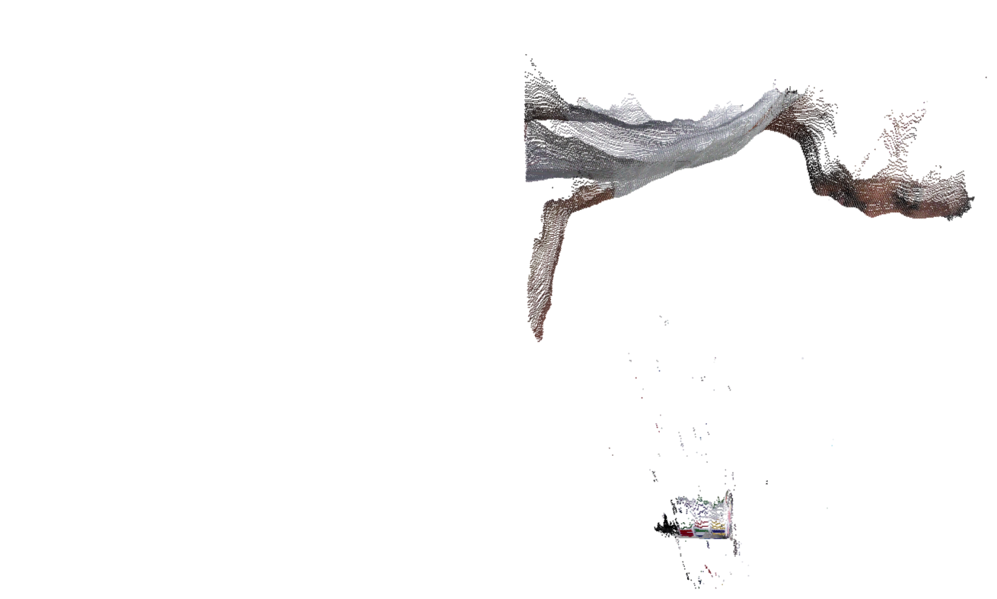
3
-2
-1
0
0
2
-2
2
-2
0
0
2
-2
1
4
-2
0
1
-3
1
4
2
1
1
1
3
1
3
1
1
1
3
1
2
6
4
4
5
2
-5
1
1
0
2 -4 4 -4 2 0 2 -4 3 3 -6 2 1 -4
Second Oder of
difference
First Oder of
difference

Slide 2
3
-2
-1
0
0
2
-2
2
-2
0
0
2
-2
1
4
-2
0
1
-3
1
4
2
1
1
1
3
1
3
1
1
1
3
1
2
6
4
4
5
2
-5
1
0
2
-4
4
-4
2
0
2
-4
3
3
-6
2
1
-4
Second Oder of
difference
First Oder of
difference

Slide 3
3
-2
-1
0
0
2
-2
2
-2
0
0
2
-2
1
4
-2
0
1
-3
1
4
2
1
1
1
3
1
3
1
1
1
3
1
2
6
4
4
5
2
-5
1
0
2
-4
4
-4
2
0
2
-4
3
3
-6
2
1
-4
0 1 0 0 0 1 0 0 0 0 0 1 0 0 0 0 0 0 0 0
Second Oder of
difference
First Oder of
difference

Slide 4
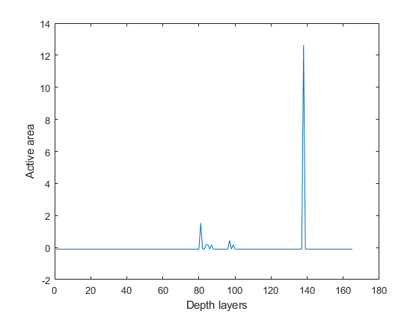
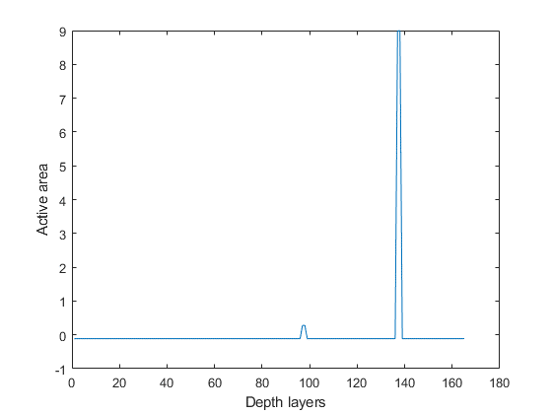
Conventional M-WRP
WRP = 55
WRP = 83
Parameters:
Object Depth: 0.024812
No. of object point: 97,396
No. of depth layers: 165
Object to Hologram: 0. 5
Resolution: 1980 X 1024

Slide 5
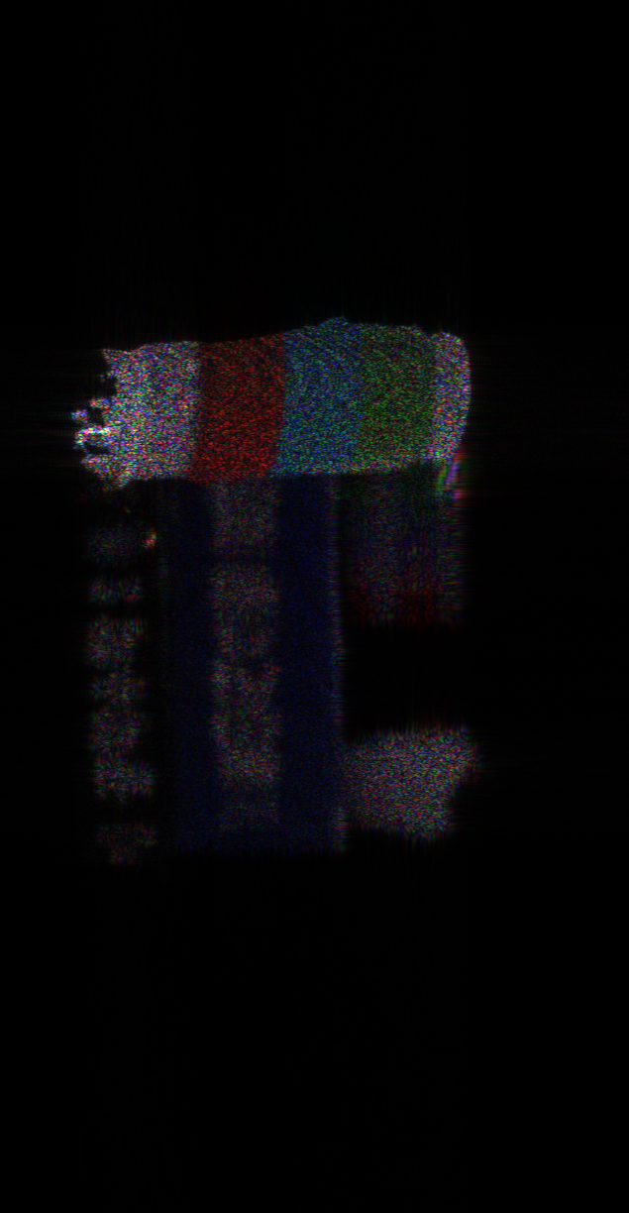
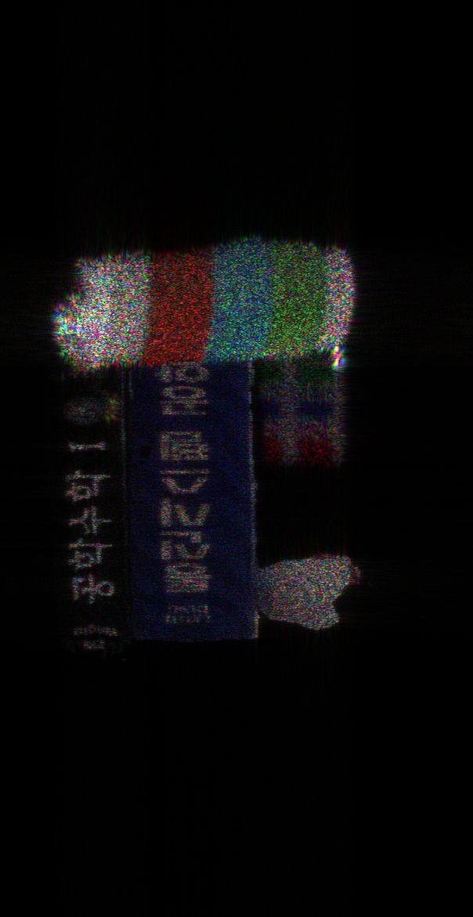

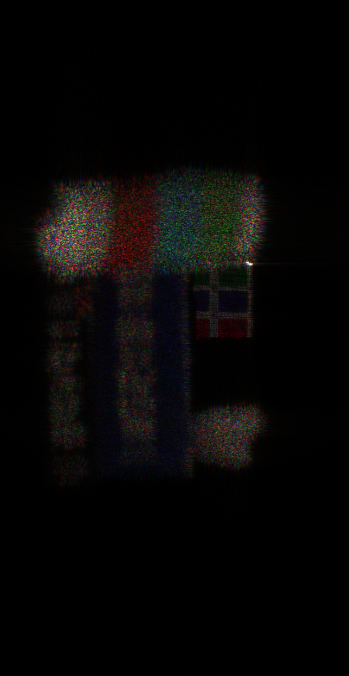
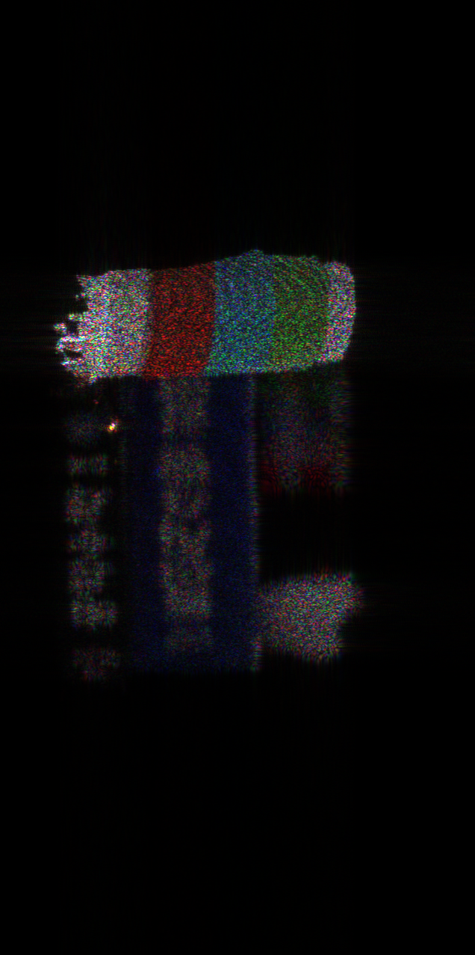
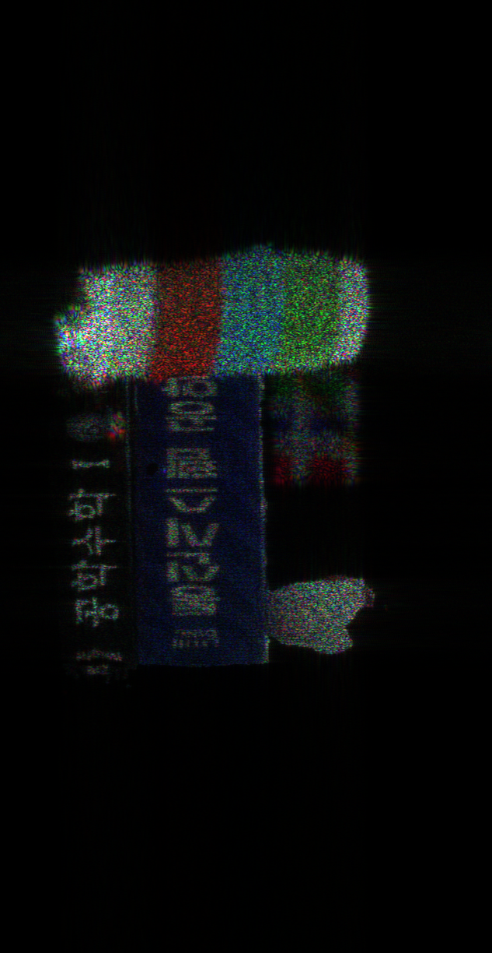
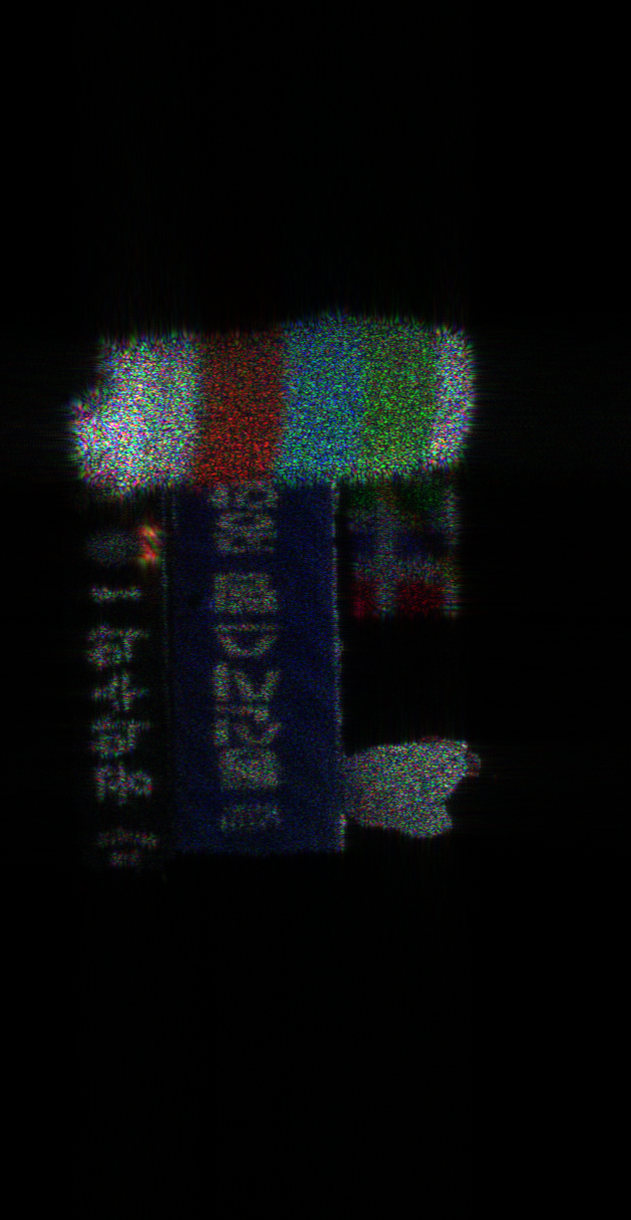
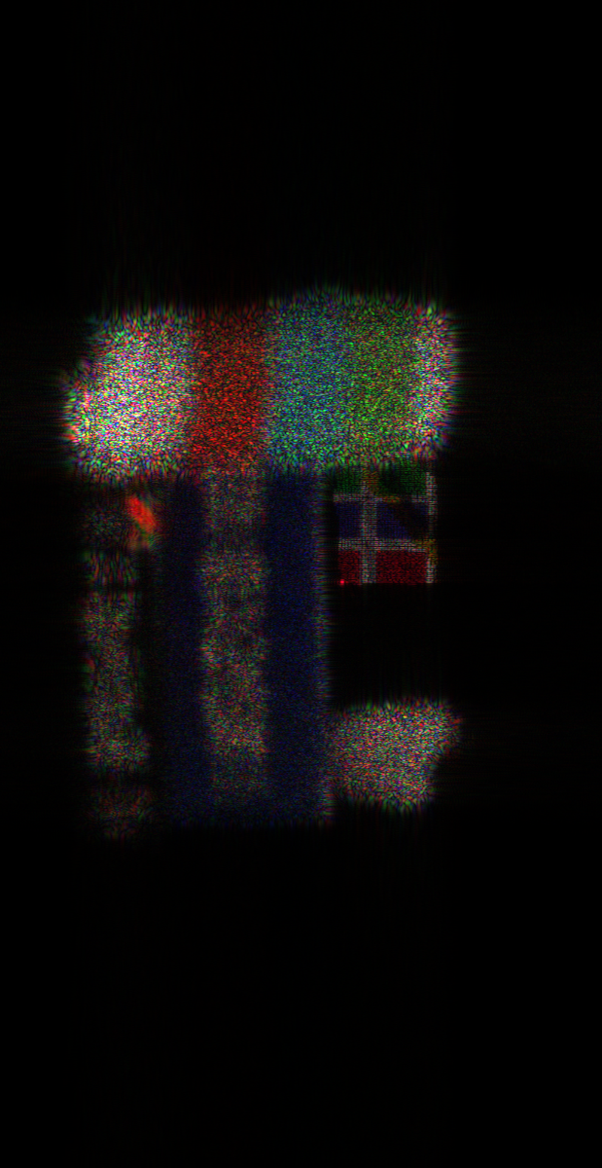
Conventional M-WRP
No. of WRP: 83
Time: 391.9311
PSNR: 22.2291
DM-WRP
No. of WRP: 73
Time: 380.9517
PSNR: 22.2674
Focused on Cup
d = 0.488
Focused on Book
d = 0.479
Focused on Chicken
d = 0.476
Focused on Cube
d = 0.467

Slide 6
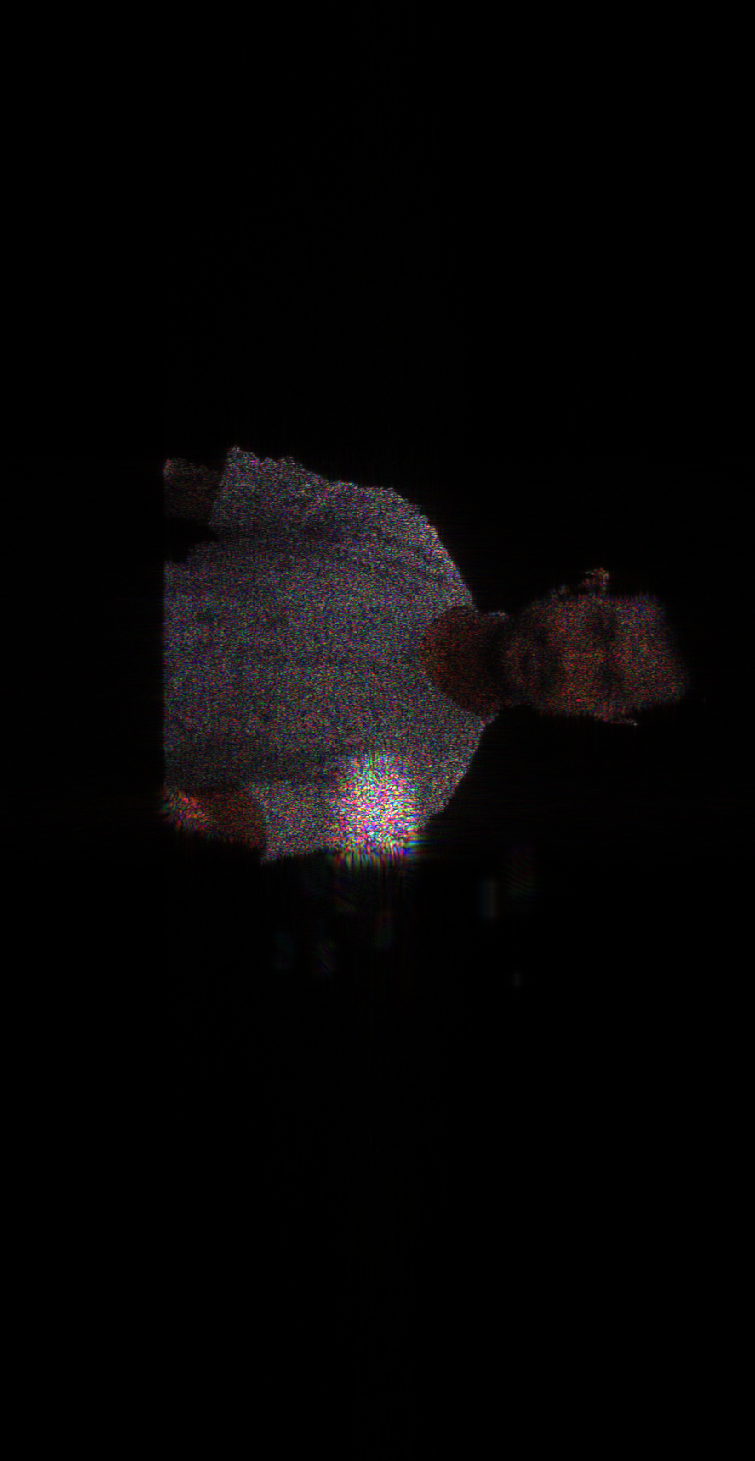
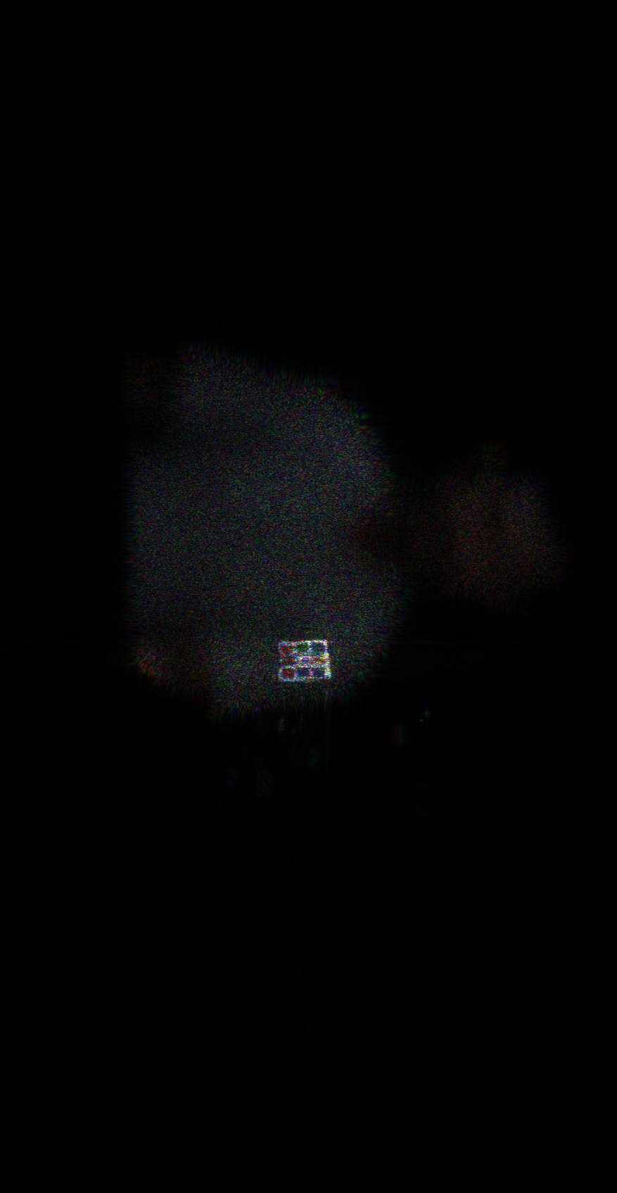
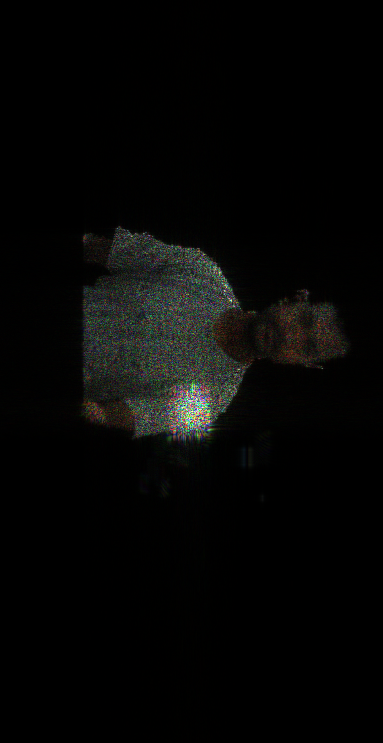
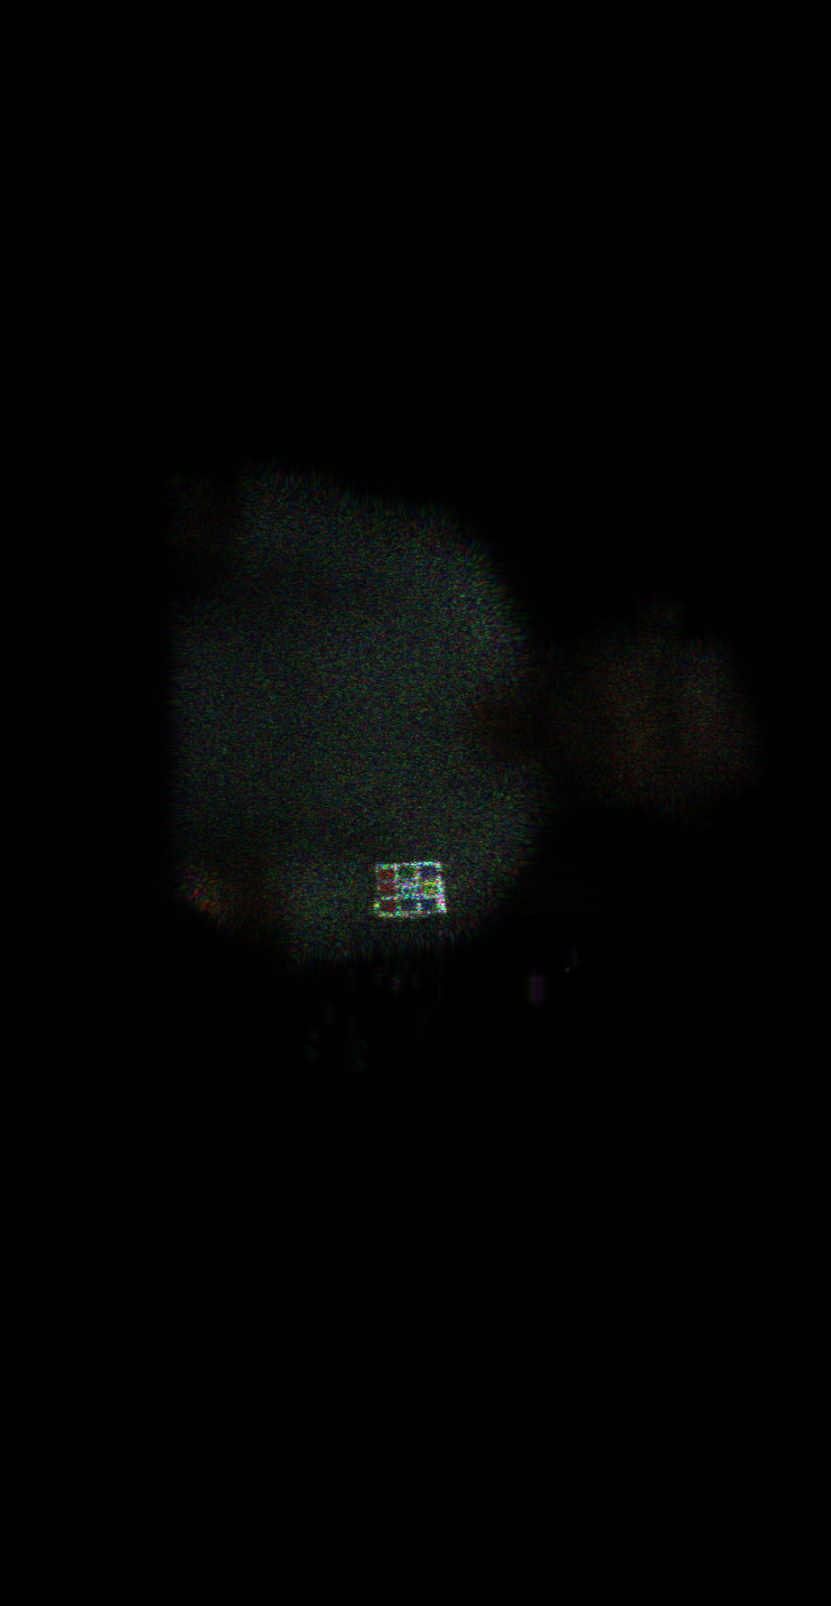
Convention M-WRP
No. of WRP: 246
Time: 463.9067
PSNR: 24.2
Parameters:
Object Depth: 0.021717
No. of object point: 87,189
No. of depth layer: 491
Object to Hologram = 0.35
Resolution: 1980 X 1024
DM-WRP
No. of WRP: 233
Time: 457.984684
PNSR: 24.1
Focused on person
d = 0.342
Focused on cube
d = 0.327

Slide 7
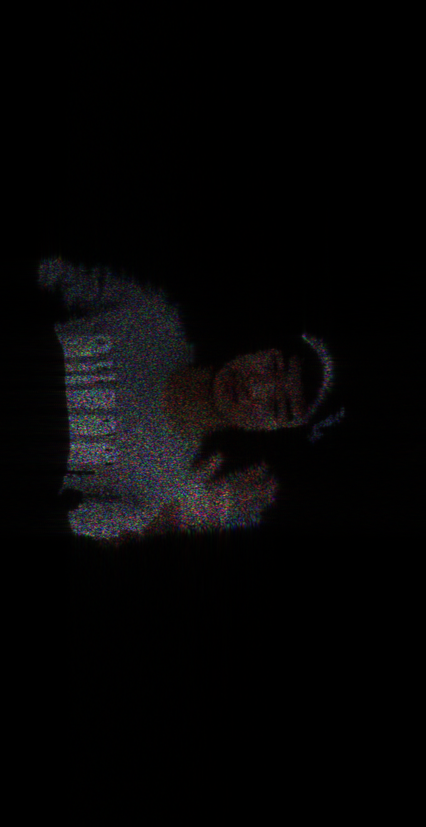
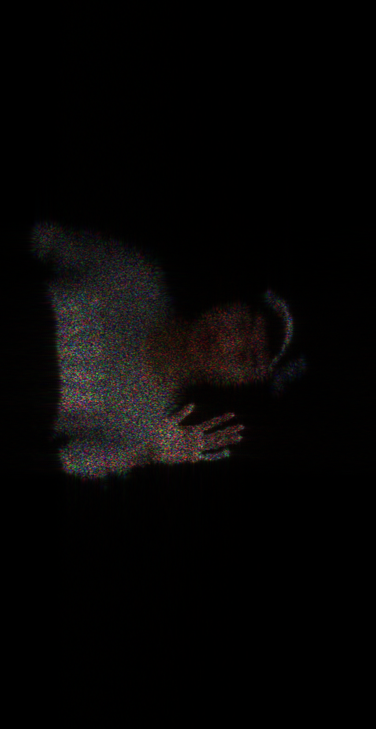
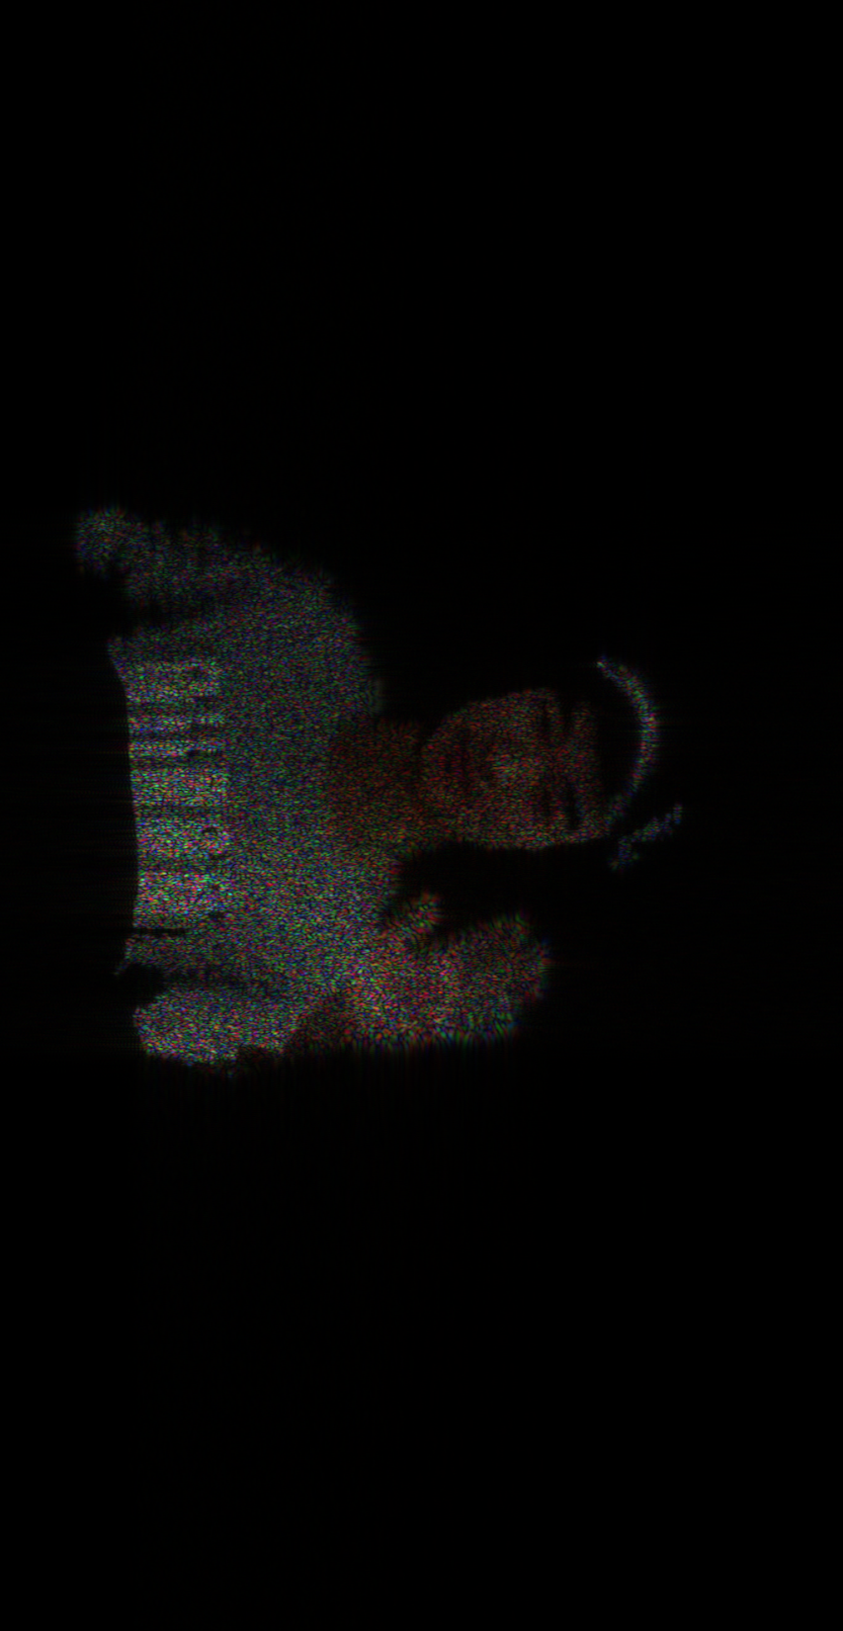
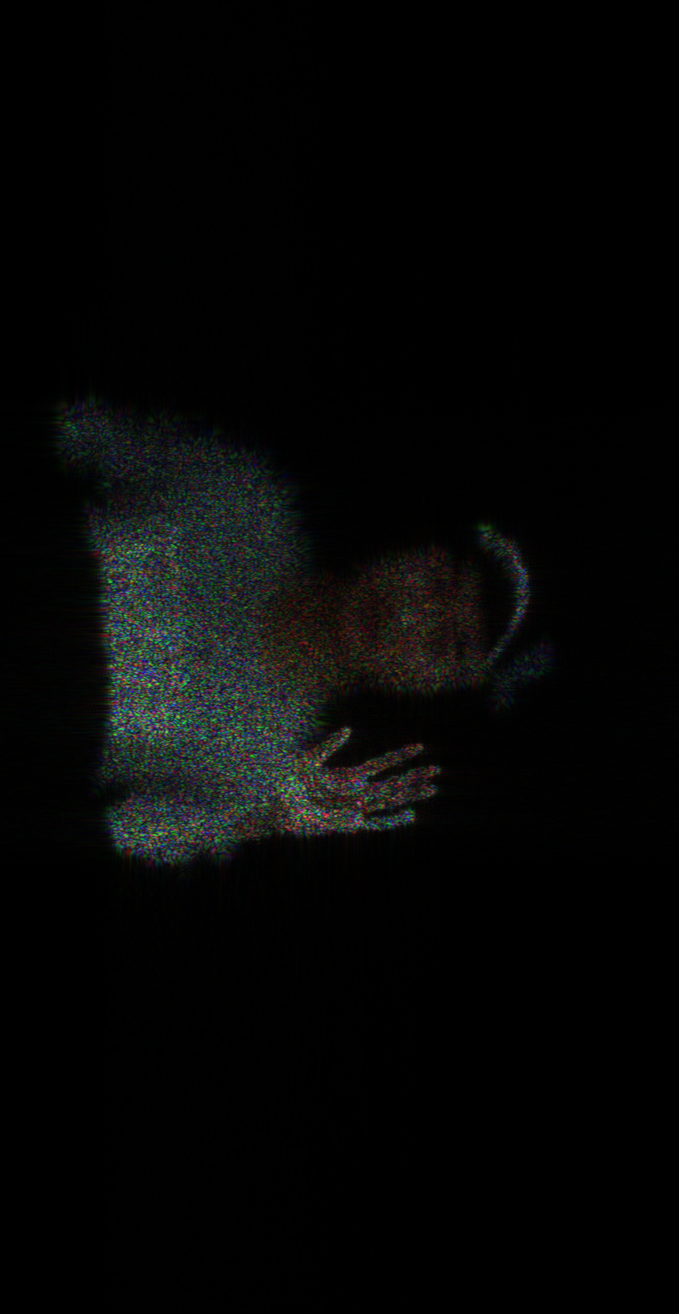
Convention M-WRP
No. of WRP: 149
Time: 704.2001
hand_PSNR: 21.06
Person_PSNR: 21.70
Parameters:
Object Depth: 0.024132
No. of object point:
No. of depth layer: 297
Object to Hologram = 0.5
Resolution: 1980 X 1024
DM-WRP
No. of WRP: 140
Time: 693.2445
hand_PSNR: 21.19
Person_PSNR: 21.55
Focused on person
d = 0.462
Focused on hand
d = 0.471

Slide 8
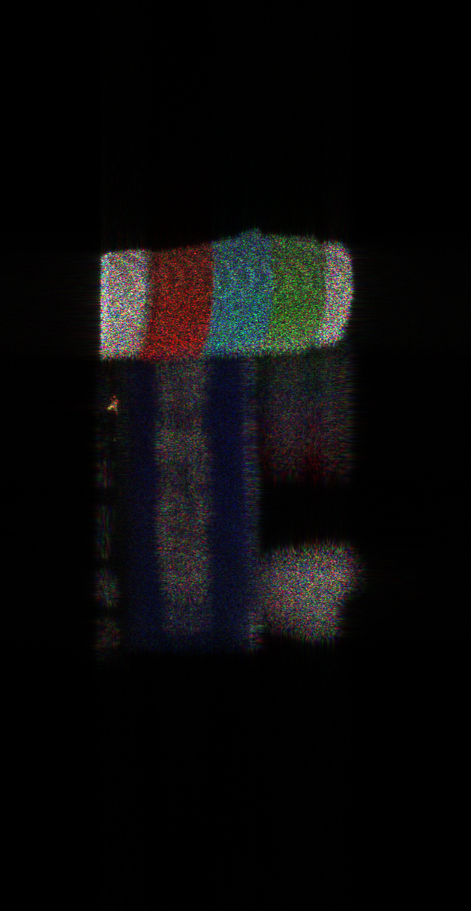
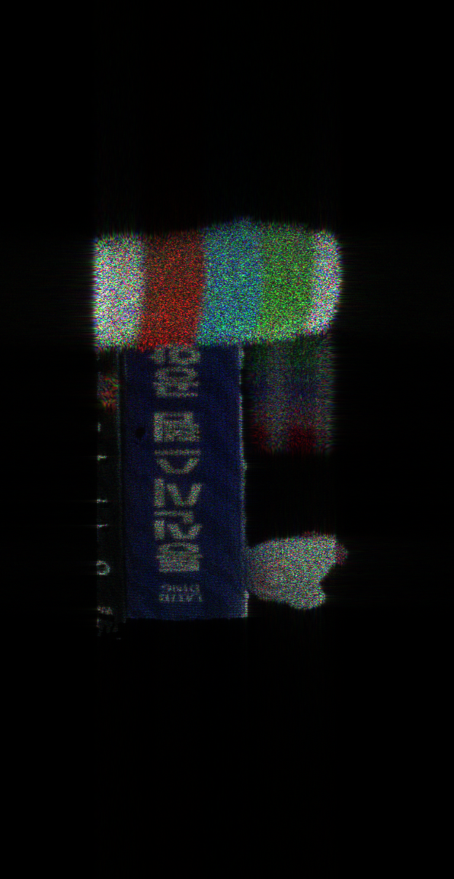
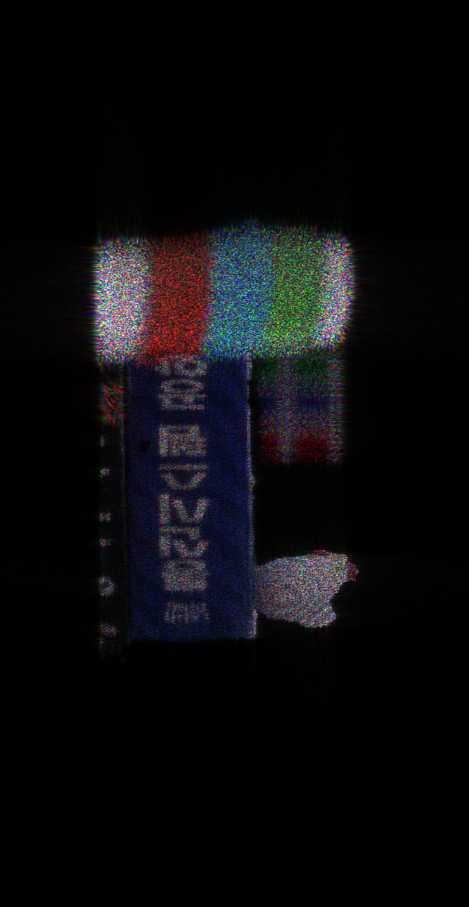
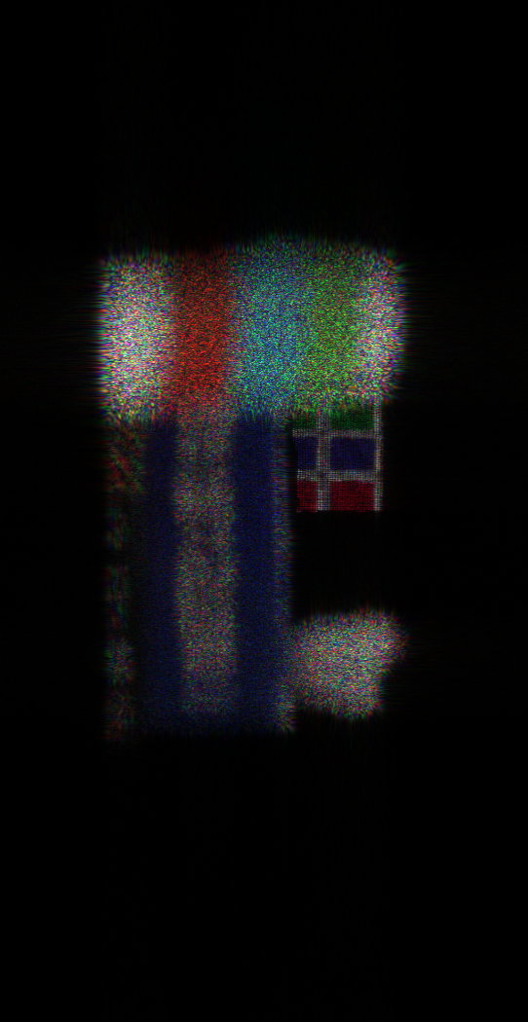

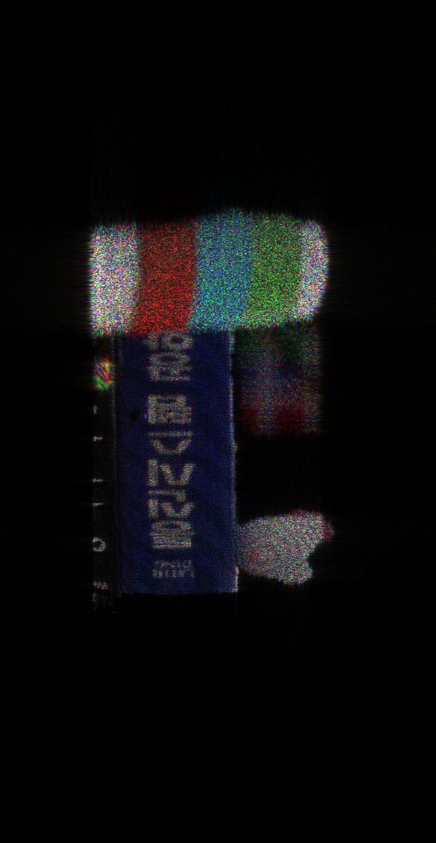
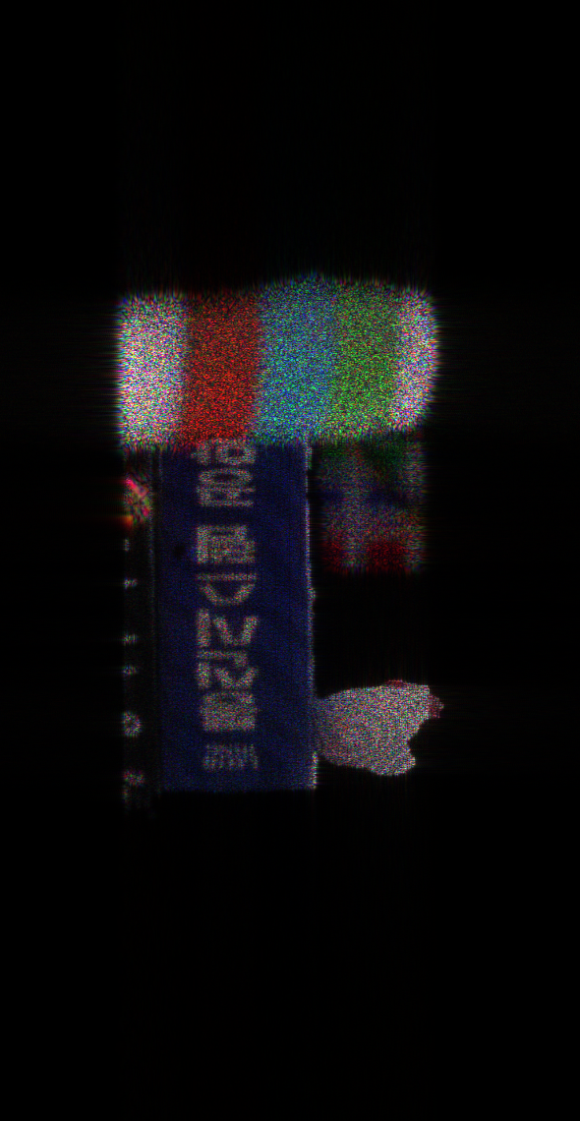
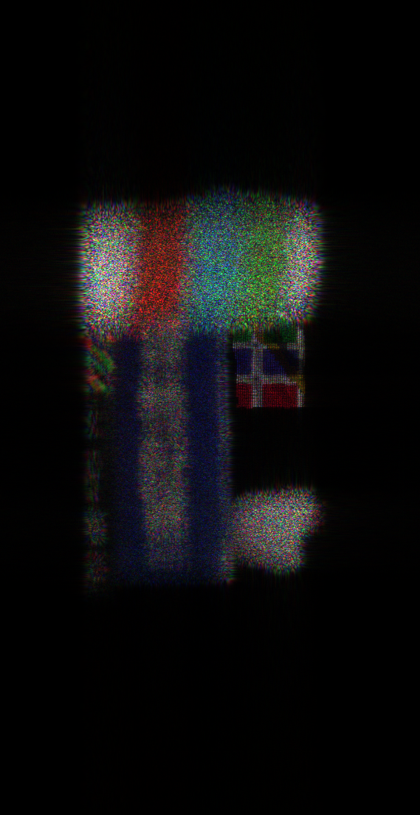
Parameters:
Object Depth: 0.024979
No. of object point: 81,155
No. of depth layers: 144
Object to Hologram: 0.35
Resolution: 1980 X 1024
Conventional M-WRP
No. of WRP:72
Time: 365.0702
PSNR:
DM-WRP
No. of WRP:64
Time: 362.717772
PSNR:
Focused on Cup
d = 0.336
Focused on Book
d = 0.330
Focused on Chicken
d = 0.327
Focused on Cube
d = 0.0318

Slide 9
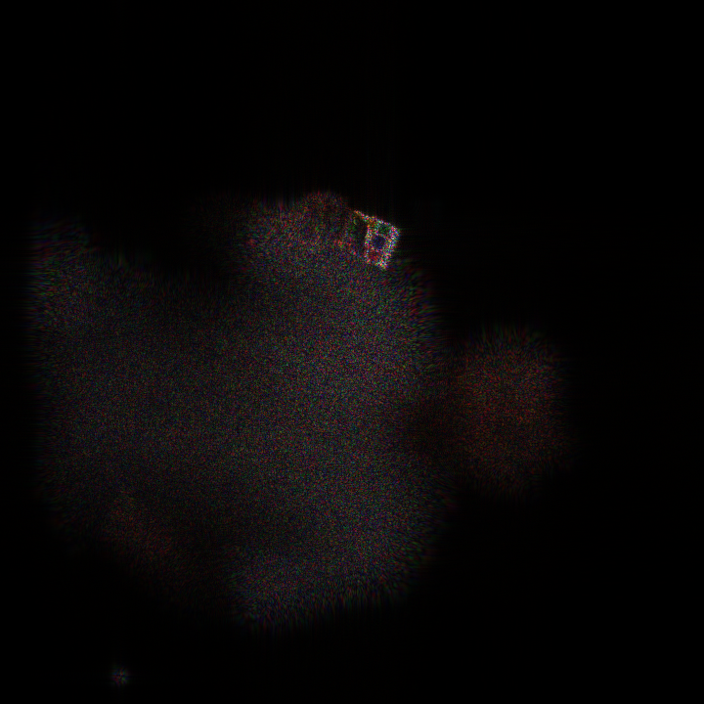
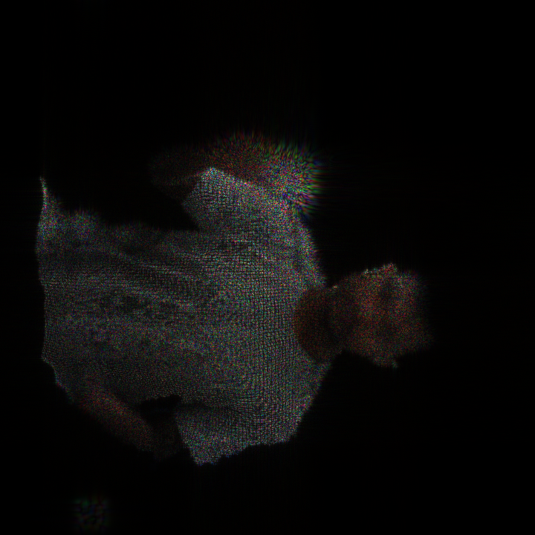
DM-WRP
Resolution: 720 X 720
Depth : 0.018346
WRP: 201
Cube:0.107
Face:0.099

Slide 10
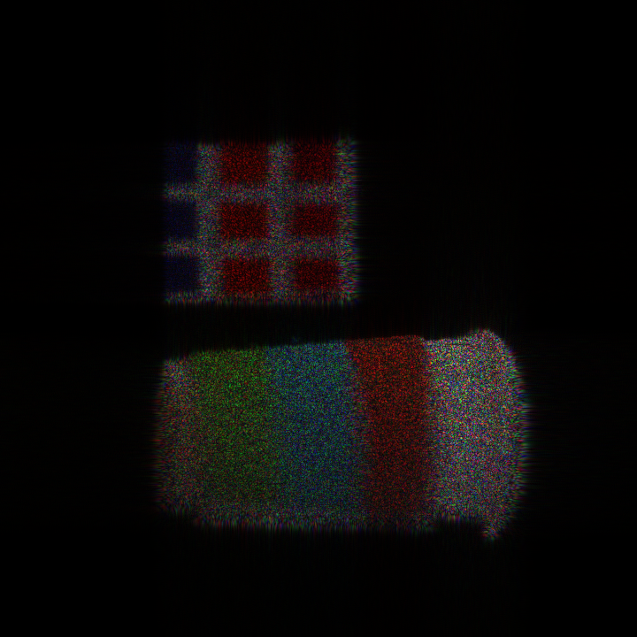
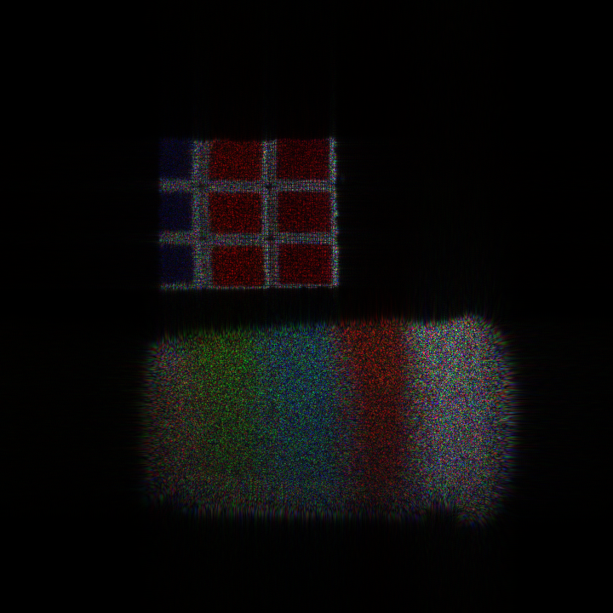
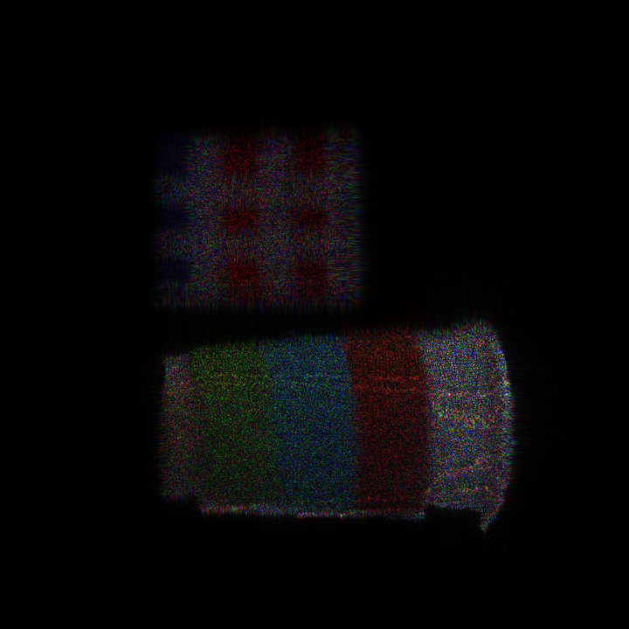
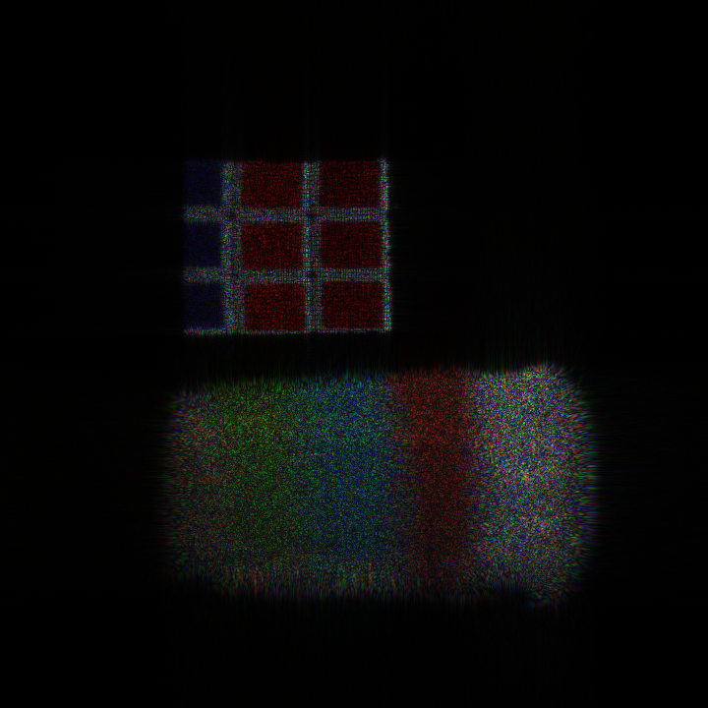
Conventional M-WRP
Resolution: 720 X 720
Depth : 0.02037
WRP:29
Cup: 0.114
Cube : 0.111
Time: 86.8904
DM-WRP
Resolution: 720 X 720
Depth : 0.02037
Cup: 0.111
Cube :0.117
WRP:25
Time : 86.3343

Slide 11
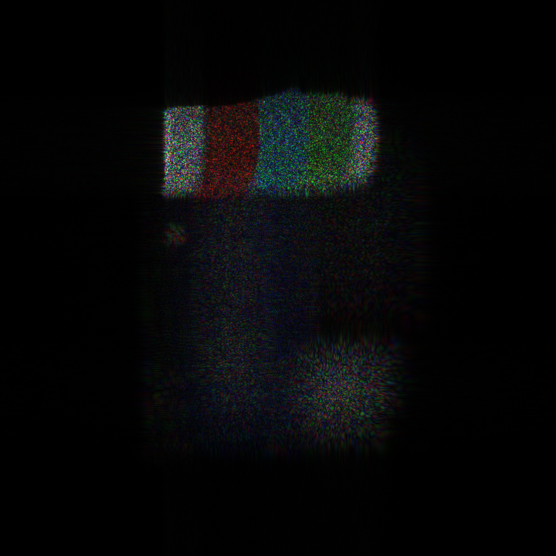
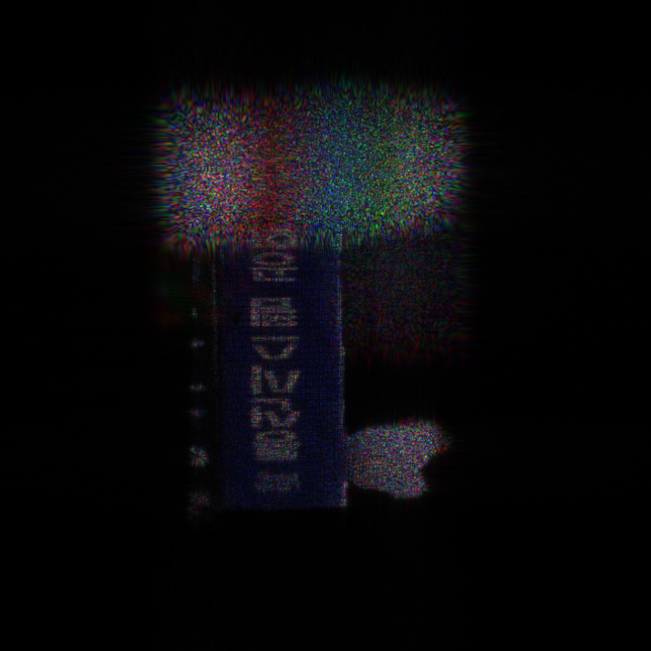
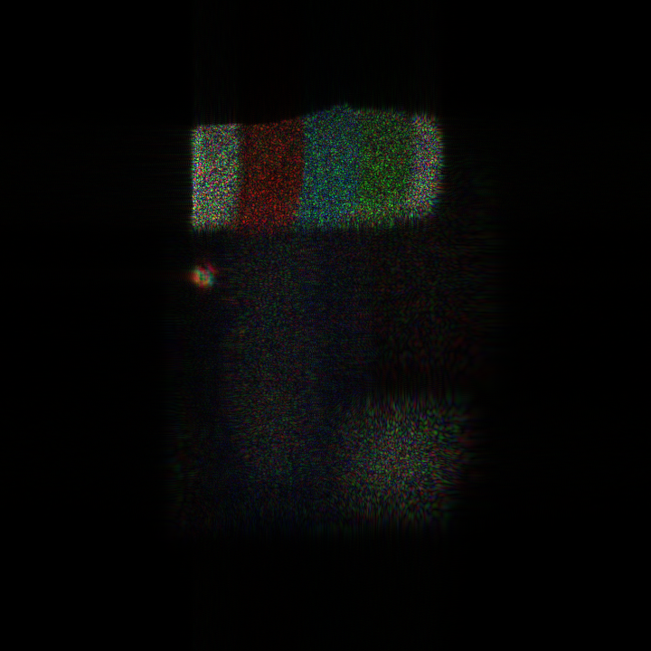
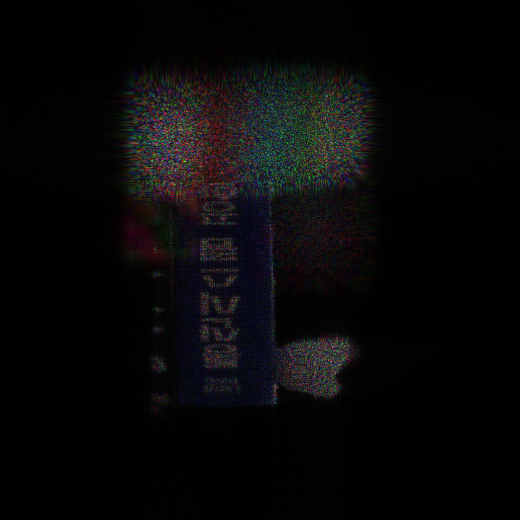
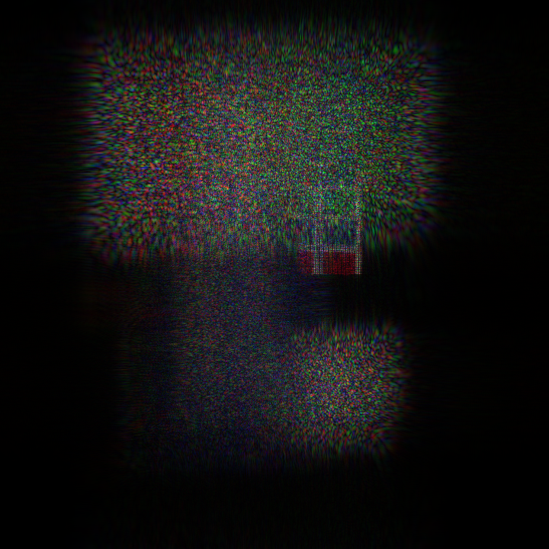
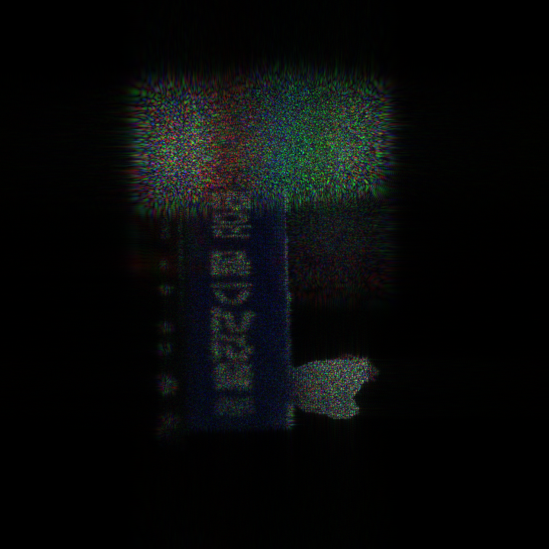
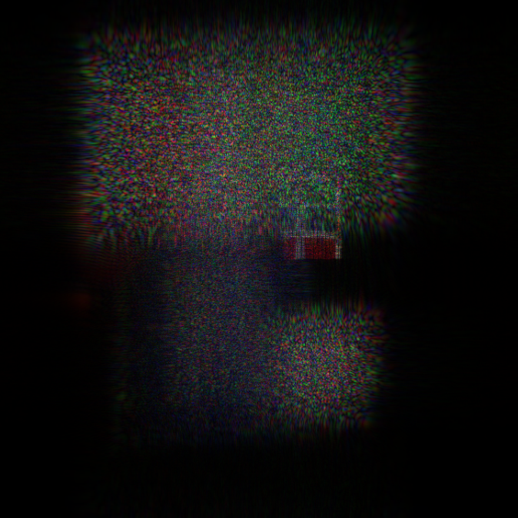
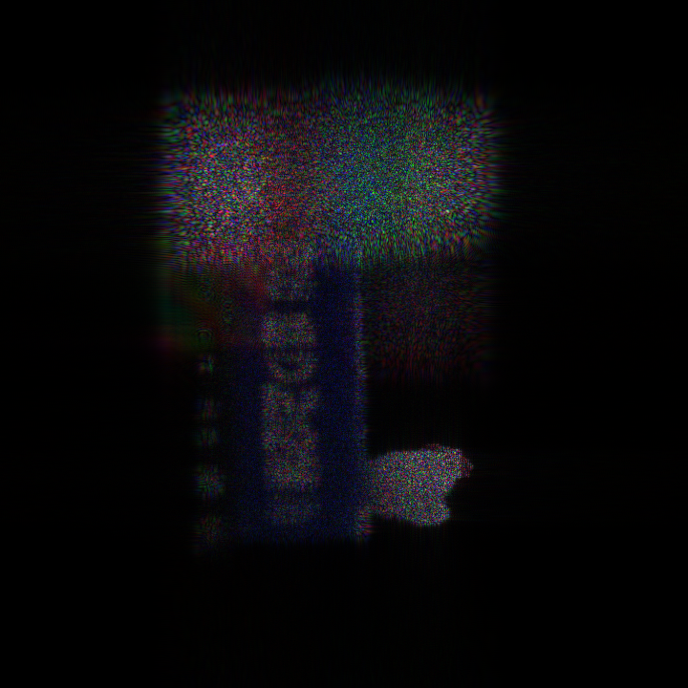
Conventional M-WRP
Resolution: 720 X 720
Depth : 0.0374
WRP:72
Cup: 0.0132
book: 0.118
cube: 0.101
Chicken:0.116
Time: 122.228429
DM-WRP
Resolution: 720 X 720
Depth : 0.0374
WRP:64
Cup: 0.0132
book: 0.1180
cube: 0.101
Chicken:0.1160
Time: 122.3459

Slide 12
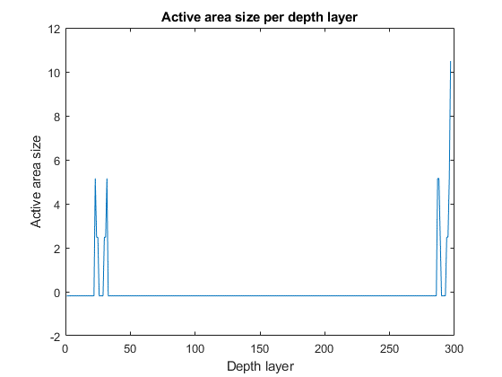
DM-WRP

